Slide 1
February 2020
Notes:
Tom – Marquette buzz words – what makes us unique

Slide 2
Communication…it’s OUR job
“Achieving an engaged and passionate alumni community requires effective communication across all available mediums with the goal of creating collaboration and raising the profile of Marquette University.”
Source: MUAA Strategic Plan
Notes:
Tom

Slide 3
Objectives
Increase overall awareness of MUAA, the National Board, and benefits of being a Marquette alumnus/a
Introduce MUAA, the national board and alumni benefits to students and new alumni
Increase alumni engagement
Position MUAA to better communicate about and advocate for the alumni experience
Notes:
Tom

Slide 4
Since our last meeting…
November – Unofficial/informal Communications committee/task force
November – Governance call to discuss communicating National Board impact, Class of 2020 Comm Plan
December – OMC Focus group on Marquette Today and more
January/February – Input provided on Alumni Benefits page, MUAA website, Pedro Arrupe Award promotion
Notes:
Tom

Slide 5
A continuous, iterative process
Where are we today?
What will we say/do?
Notes:
Tom

Slide 6
Key themes and messages
3-4 points you want alums to remember
Should support Advancement outcomes and connected to Beyond Boundaries
Should be simple, honest, consistent, repeatable
Notes:
Tom
Reference “sharing your Marquette story” session during our October meeting with Nicole. Reference draft document you created that could help ensure consistent messaging around MU and might support our Board’s communications/conversations within their networks.

Slide 7
Audience | Activity/Event | Purpose/Topics/Message | Media Vehicle | Frequency | Measurement | Responsible
All MU Alumni
All MU alumni | Publish stories online and in print | Update on key initiatives, highlight student and alumni success stories, reinforce Jesuit value proposition and MU mission | Alumni news Marquette magazine Discover magazine MUAA website | Monthly 3X a year Annual | Open rate/clicks Surveys Feedback | UA OMC OMC
 | National Marquette Day Feb. 9 | Express and grow school spirit | Email In-person gatherings | Annual | Participation # gamewatches | UA
 | Give Marquette Day 2020 – Feb. 27 | Solicit donations | Email Targeted emails via Volunteer Portal Social media | As needed; at least once | # donors responses | UA
 | Timely, current news | Initiatives update MBB Key events | Instagram Facebook Twitter YouTube Pinterest Linked In Four Square Tumblr Flickr | As needed | # views | UA, OMC
 | Christmas | Express goodwill, gratitude | Email/video | Annually | Open rate Feedback
 | Lent/Advent retreats | Promote Ignatian spirituality | Email | Once a year | Feedback | X
Cross-section of alumni | Special campus events - M Club Hall of Fame Induction | Engage and inform | Face to Face | 1x/year | Feedback
ENGAGEMENT EVENTS
Notes:
Sarah – example of the what we communicate around – NMD, Christmas, Lent, GMD

Slide 8
Audience | Activity/Event | Purpose/Topics/ Message | Media Vehicle | Frequency | Measurement | Responsible
College/Unit Leadership Councils, College-based alumni groups and Interest-based groups
Arts & Sciences Business Communications Dentistry Education Engineering Health Sciences Law Nursing Innovation Grad School BAA, HAA, LGBT, AMUW + | Meetings/Events Volunteer Summit Publish magazine | Dean’s message Key initiatives Curriculum Success stories | Magazine | Annual Bi-Annual (Law and Dentistry) | Feedback | UA
Marquette Volunteers
Representatives of various alumni organizations | Volunteer Summit | Flow down of communications | Face to Face | Annual | Feedback | UA/Owen Sullivan/BOT
Other Audiences
MU Mentors | Meeting/Events | Networking | In person/virtual | Once per year | Feedback | UA
National Alumni Board | Meeting | Participation | In person | 3X a year |  | UA
President’s Advisory Council/Campaign Executive Committee | Meetings | Participation | In person | Each semester | Comments | UA
Young Alumni Leadership Council | Meeting | Participation | In person | As scheduled | Comments | UA
Reunion, Awards, and events and leadership giving events (Presidents Society), virtual retreats | Meeting | Participation | In person | As scheduled | Comments | UA
Notes:
Sarah
Diverse group of audiences and volunteers with different purposes – college leadership councils, interest-based groups – HAA, BAA, Mentors, campaign

Slide 9
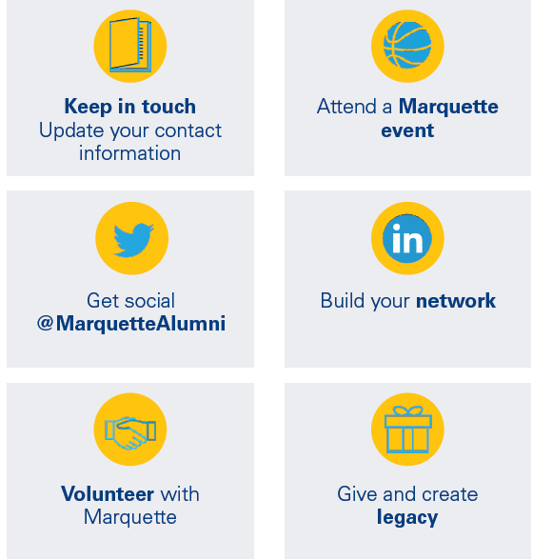
Progress
Pedro Arrupe Recipient – Rachel Belifuss
Feature in COHS May Magazine
Spotlight in COHS social media, Alumni Association social media
Alumni newsletter/website, etc.
Volunteer Appreciation Dinner print program/AV
Backpack Program – power of collective giving
NB leading by example - listed as donors on website
NB to be featured on Giving site, etc. to inspire others in MUAA
Welcome new graduates into the Alumni Association
Notes:
Sarah
Welcome new graduates into the alumni family at cap & gown pickup before commencement (May 2019).
o Collect updated contact info
o Alumni ID cards, a small welcome gift, and postcard with key messaging (see below).
o New this year: celebratory photobooth and a sweet treat
Summer communication (mid-May thru August 2019).
o Mailed postcard in mid-June
o Series of emails
o Both methods will promote special regional events geared toward new grads (Marquette Mixers) and connecting with volunteer opportunities, including regional clubs, admissions and reunion.
Regional club outreach and Marquette Mixers (August 2019).
o Regional club leaders will reach out to new grads who indicated they would like to be contacted to welcome them to the area and share upcoming opportunities to get involved.
O Marquette Mixers - regional clubs are asked to host an event in August to welcome new grads to the area.
Young Alumni Association Homecoming Gathering (October 2019).
The Young Alumni Association will host an event during the Reunion + Homecoming weekend, open to all young alumni, that will raise funds for scholarship.
o All new grads will receive a special invitation to attend this event, highlighting making a gift to Marquette.
First idea: include a quote from each board member about why they joined the board and/or what they get out of giving back?
2nd thought: include a graphic that shows the demographic representation of the board, e.g., geography, class year, major...

Slide 10
Next steps
Winter
Outreach to 2019 graduates via email from Executive Director and save the date for 1st reunion
Spring/Summer
Website
Alumni benefits
Marquette Mixers, cap and gown, 2020 student alumni ambassadors, senior challenge
OMC/UA Communications Audit
Are you interested in helping?
Notes:
Sarah/Tom
Celebratory event for key student volunteers in spring 2020. Encourage graduating seniors to stay connected and engaged after graduation:
o Student Alumni Ambassadors
o Senior Challenge/Student Philanthropy Leadership Council
o UA Student Assistants
o Student leaders across campus

Slide 11
Notes:
Tom

